Slide 1
Targeted Mutagenesis in Polyploid Species
TJ Wiegman
AGRY 530
2023-11-28

Slide 2
Outline
Background
Polyploidy
Mutagenesis Technologies
Site-specific Endonucleases
Polyploidy & Genetic Engineering
Highly Heterozygous Lines
Hybrids & Sterility
Case Study: Multiplex Editing Hexaploid Wheat
Background
Methods
Results

Slide 3
Background
Polyploidy, Mutagenesis, and CRISPR

Slide 4
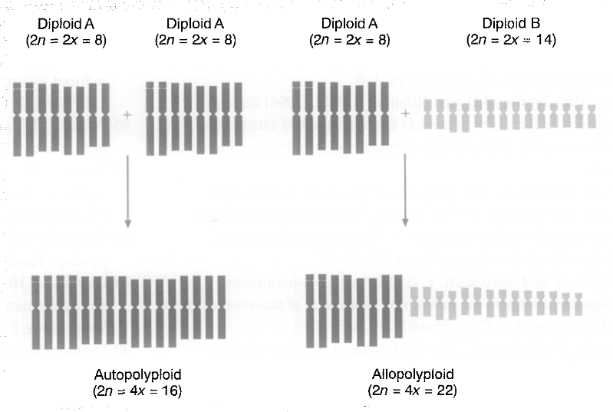
Background
Polyploidy: multiple genomes in one organism
Autopolyploid
Allopolyploid

Slide 5
Background
Mutagenesis Technologies
Random Mutagens (gamma rays, EMS)
Direct Gene Transfer (heat shock, electroporation, etc.)
Agroinfiltration (bacteria or viral vectors)
Site-specific Endonucleases (i.e. CRISPR/Cas)

Slide 6
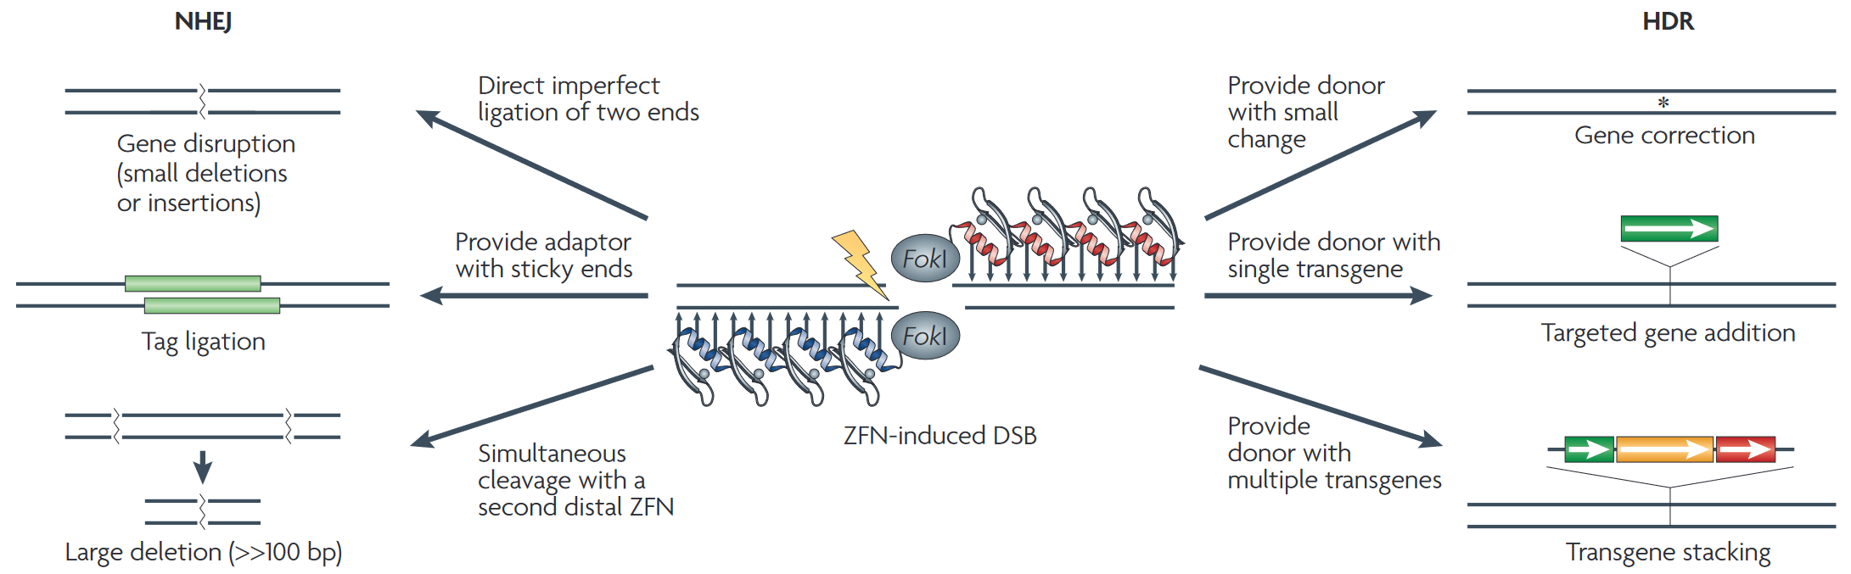
Site-Specific Endonucleases
Zinc Finger Nucleases (ZFNs)
Transcription Activator-Like Effector Nucleases (TALENs)
Clustered Regulatory Interspaced Short Palindromic Repeats (CRISPR) and CRISPR associated (Cas) protein
Non-Homologous
End Joining
Homology-Directed Repair

Slide 7
Polyploidy & Genetic Engineering
Opportunities for Elite Crops

Slide 8
Backcrossing Elites
Elite crops: very polyploid, highly heterozygous
Require a lot of backcrossing to purify
“Yield Drag”

Slide 9
Sterility & Hybridization
Sex-selective sterility (CMS)
Sterile Hybrids
Vegetative propagation

Slide 10
Directed Mutagenesis
Random Mutagens 👎
Direct Gene Transfer 👎
Agroinfiltration 👌
Very well-studied, long history
Imprecise position, copy number
Site-specific Endonucleases 👑
Very precise, easy to work with
Can perform multiplex edits

Slide 11
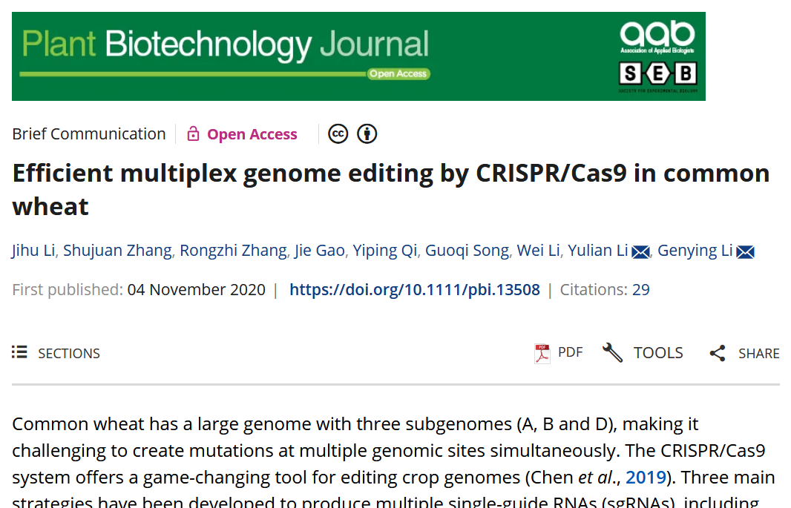
Case Study
https://bit.ly/46Bdxn4
“Efficient multiplex genome editing by CRISPR/Cas9 in common wheat”
Jihu Li, Shujuan Zhang, Rongzhi Zhang, Jie Gao, Yiping Qi, Guoqi Song, Wei Li, Yulian Li, and Genying Li (Plant Biotech. Journal 2021)

Slide 12
Background
CRISPR/Cas9, delivered via Agrobacterium
Fielder wheat:
Susceptible to Agrobacterium
Hexaploid: A, B and D genomes
Targeting three genes:
TaDA1 (A,B): a (negative) regulator of kernel size
TaPDS (A,B,D): carotenoid pathway enzyme, prevents an “albino” photobleaching phenotype
TaNCED1 (A,B,D): regulates responses to environmental stresses (e.g. temperature, drought)

Slide 13
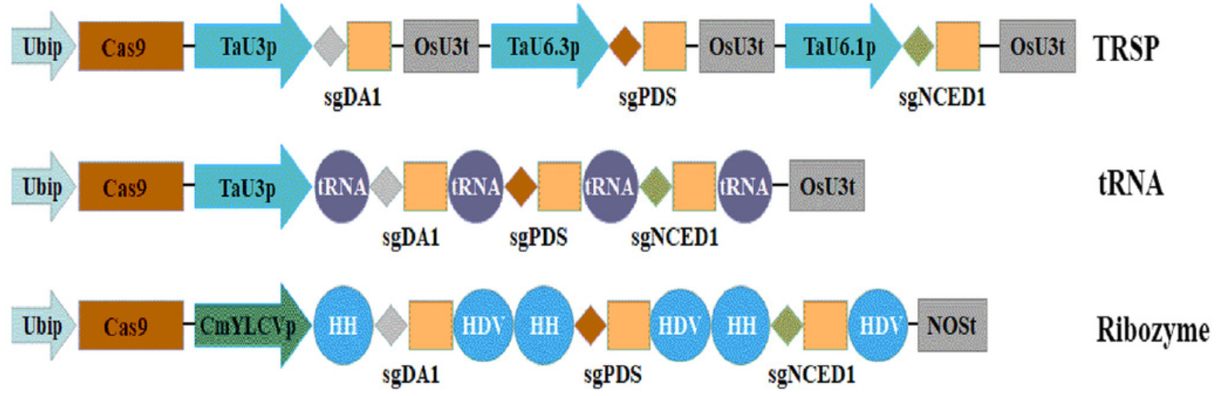
Methods
Three variations on CRISPR/Cas9: How to put multiple single guide RNA (sgRNA) in one cassette?
Tandem Repeats of Separate Promoters (TRSP)
Endogenous tRNA processing RNases (tRNA)
Synthetic Self-Cleaving Ribozyme (Ribozyme)
Figure 1a

Slide 14
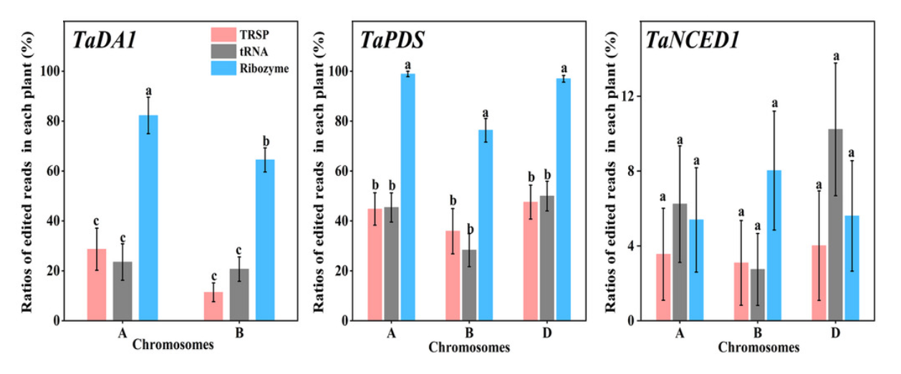
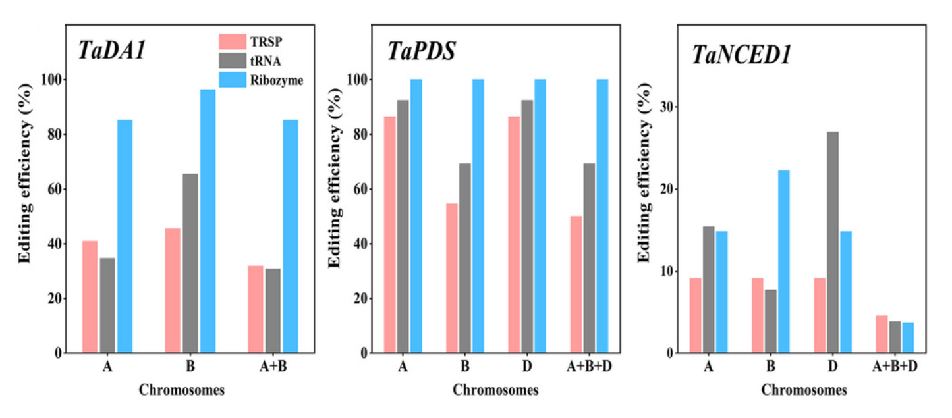
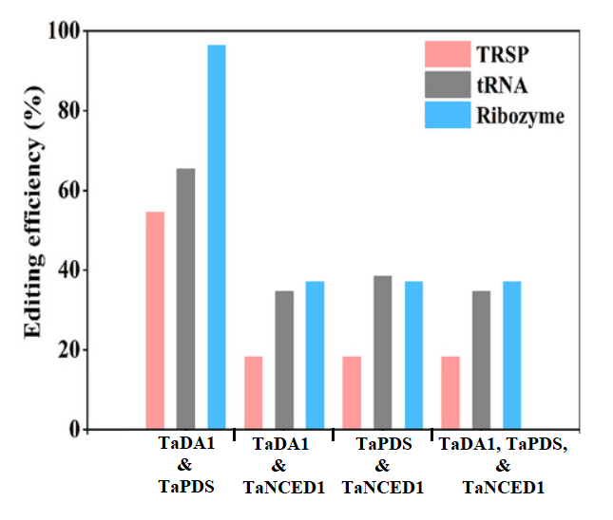
Results
Figure 1c
TRSP worst, tRNA better, Ribozyme best
Can edit on all three genomes with a single treatment
TaNCED1 hard to transform
Figure 1g
Figure 1f

Slide 15
Questions & Discussion

